Slide 1


Slide 2

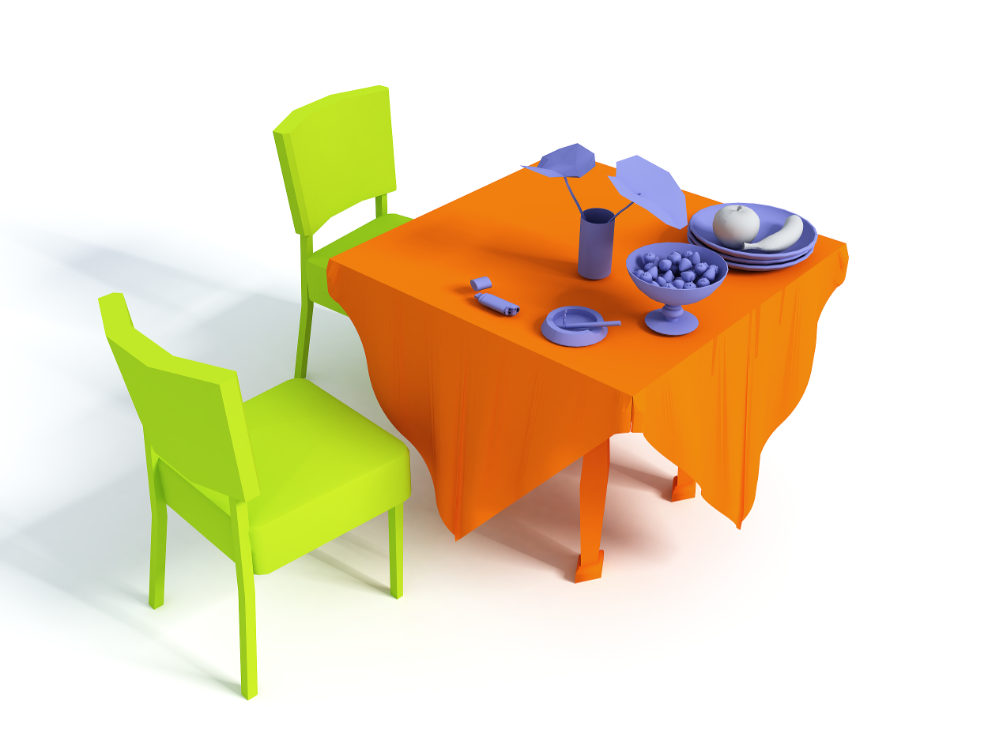
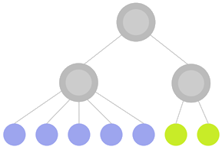






Interaction Context (ICON): Towards a Geometric Functionality Descriptor Ruizhen Hu^{1,2,3} Chenyang Zhu¹ Oliver van Kaick⁴ Ligang Liu⁵ Ariel Shamir⁶ Hao Zhang¹
A
¹ Simon Fraser University
² SIAT
³ Zhejiang University
⁵ USTC
⁴ Carleton University
⁶ IDC

Slide 3
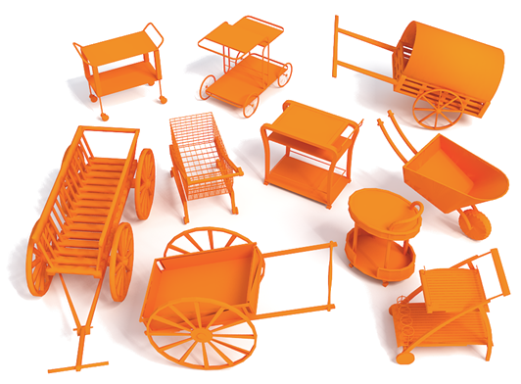
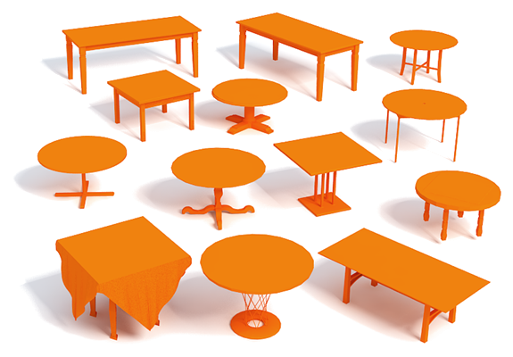
Motivation
“The essential definition of object classes is functional.”
-- Stark & Bowyer [1996]
Notes:
The long term goal of our work is to understand functionality of 3D shapes.
Functionality analysis is important, for example, those two classes of shapes are defined by their functionality even though their geometry differ a lot.

Slide 4
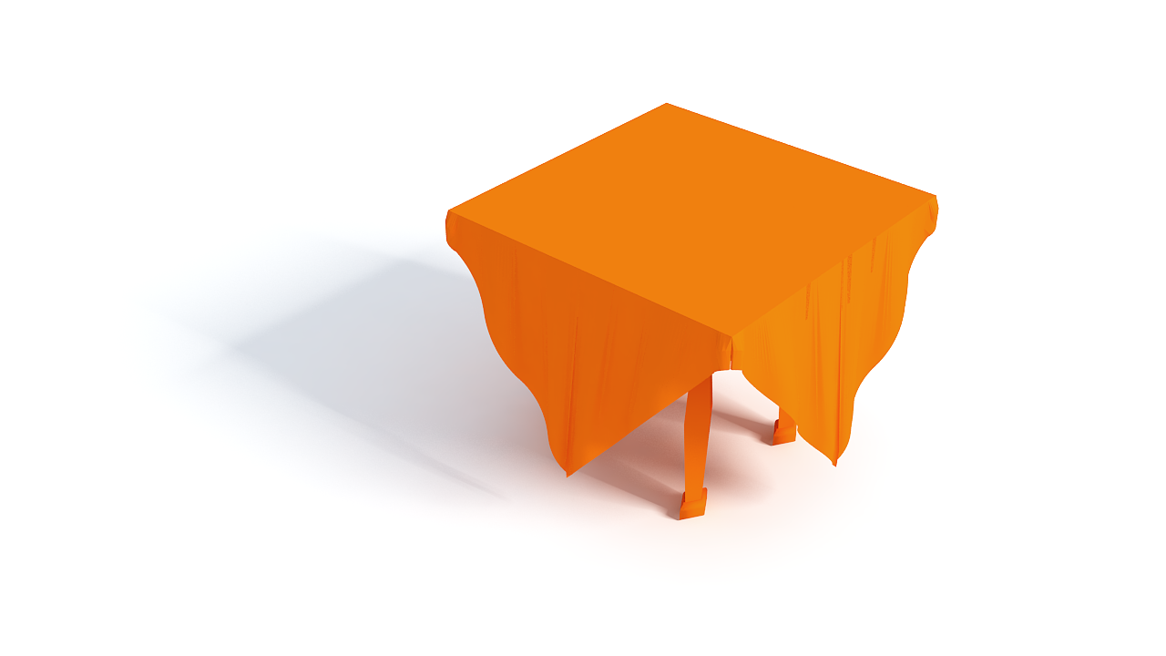
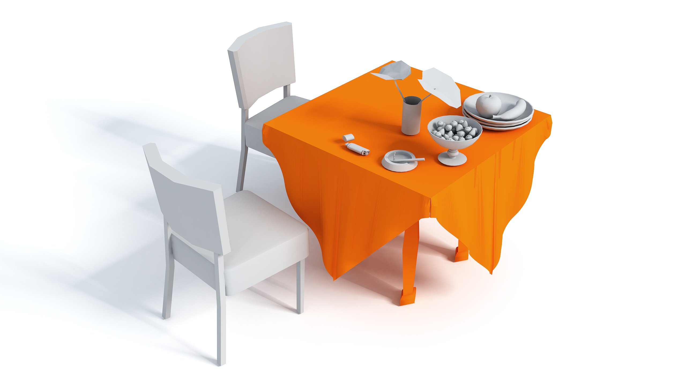
Key observation
Infer some types of functionality by considering:
Interactions
Context
Notes:
But analyzing functionality, for example of this table, is difficult.
So in this paper, we make a first and preliminary attempt to describe object functionality.[click]
Our key observation here is that some types of functionality can be derived from interactions between objects [click]
and thus the object needs to be provided in an appropriate context, which in our case is a 3D scene, where multiple interactions between objects can be present.

Slide 5
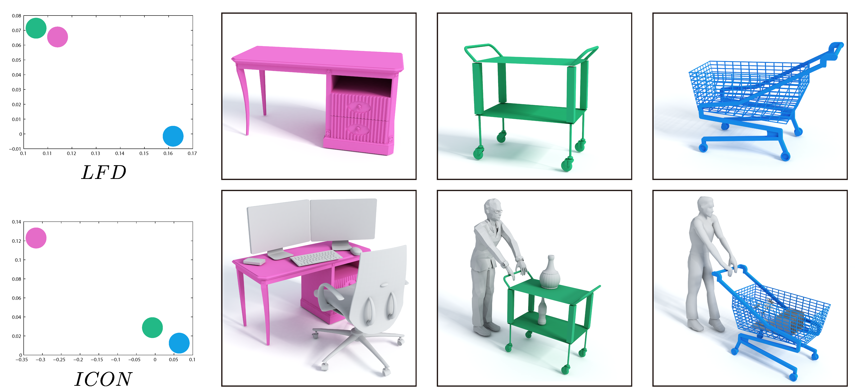
Key observation
Context & Interactions:
Notes:
Take these three shapes for example, one desk and two handcarts.
If we consider individual shape alone, [click] the geometry and structure of the green handcart is closer to that of the desk instead of the blue handcart, as shown [click] in the embedding of their light field descriptor distances on the left.
But if we look at the context [click] of those shapes and the way of how those shapes interact with surrounding objects, we can tell that [click] two handcarts are more similar to each other than the desk,
And this is actually captured by our contextual descriptor ICON as shown in the embedding.
However, there are several challenges to build such a contextual descriptor that can work well in practice.

Slide 6
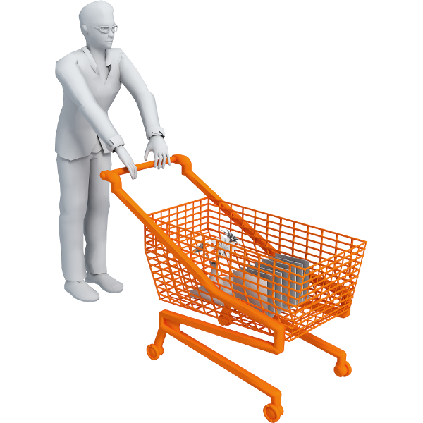
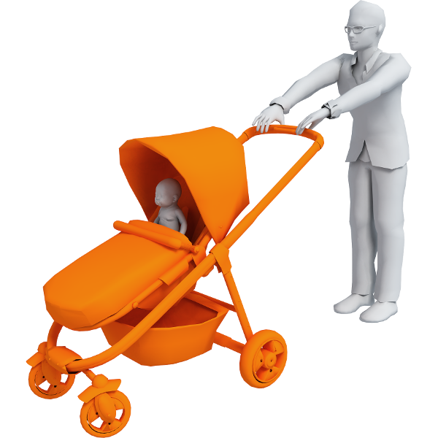
Challenges
Capture multiple, different interactions
Holding
Pushing
Notes:
First, we need to capture multiple interactions of different characteristics. [click]
For example, a shopping cart can both be [click] pushed and [click] hold grocery.
So, a single human template and its associated interaction is insufficient to describe the functionality of these shapes.

Slide 7

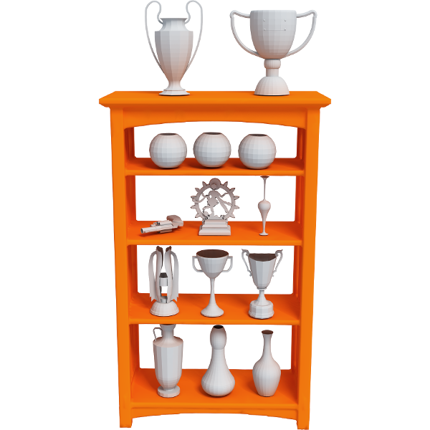
Challenges
Insensitivity to object geometry and count
Trophies
Books
Notes:
Second, the descriptor should not be sensitive to specific number of interacting objects or their geometry. [click]
For example, bookcases and cabinets are regarded as functionally similar even though there is significant variation in the number and the kinds of objects displayed, e.g., books versus trophies.

Slide 8
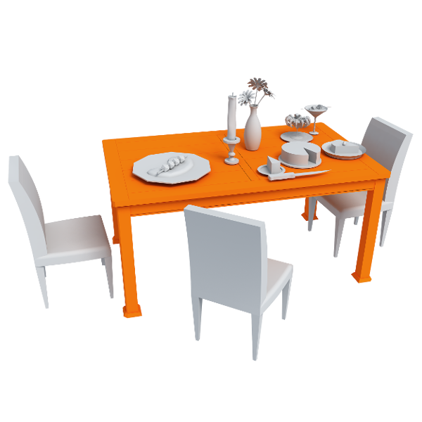
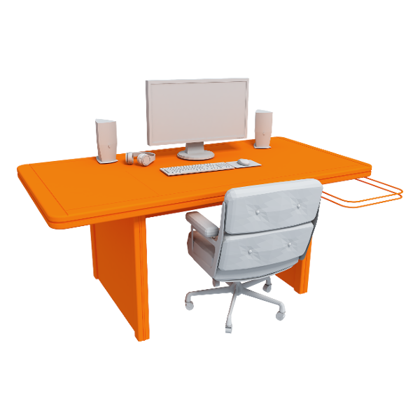
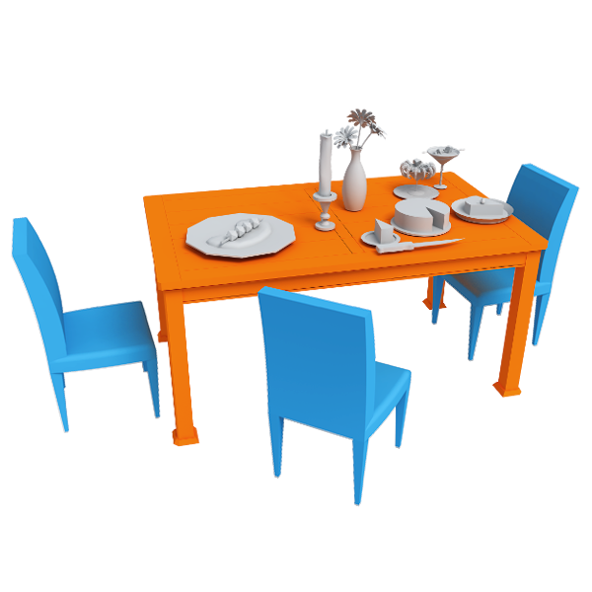

Challenges
Group interactions in a meaningful manner
Structural organization
Notes:
Finally, simply collecting all object-to-object interactions cannot fully characterize functionality.
For example, a study desk and a dining table can both be described by [click] one or more interactions with chairs; it is the way these interactions may be grouped and spatially arranged that tells the objects apart. [click]
Hence, we need to provide a structural organization of the interactions.

Slide 9
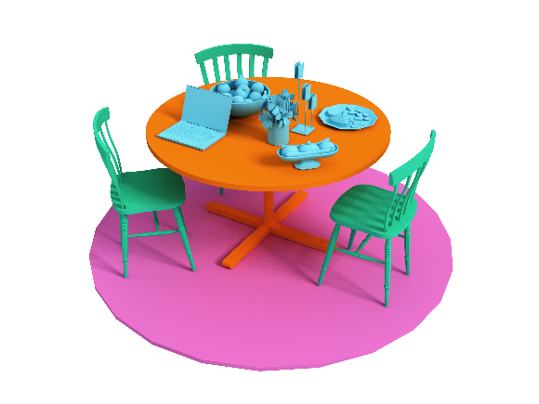
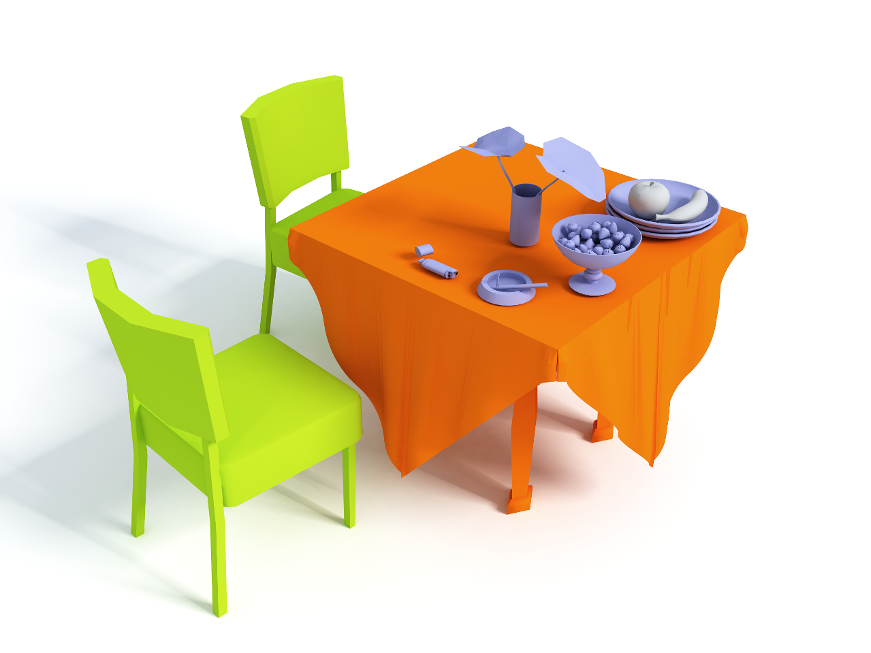
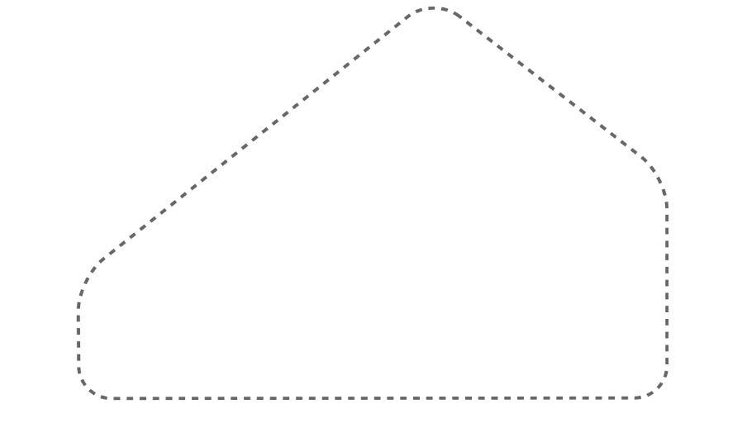
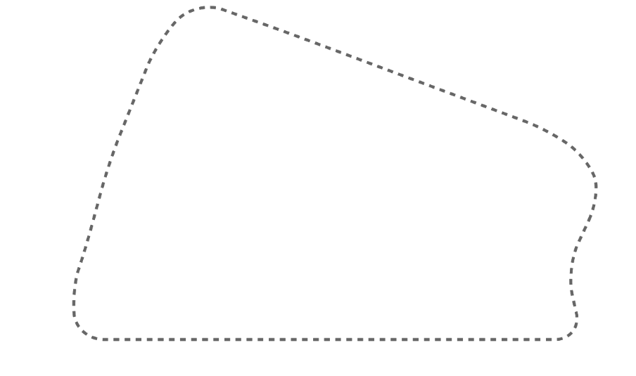
Interaction Context (ICON)
Notes:
Addressing these challenges is what behind the design of our contextual descriptor called interaction context or ICON.
ICON encodes the interactions between a central object and its surrounding objects into a hierarchy, [click] which allows us to measure the functional similarity between two shapes by [click] matching their ICONs.
Before explaining ICON in more details, let me first review some related works.

Slide 10
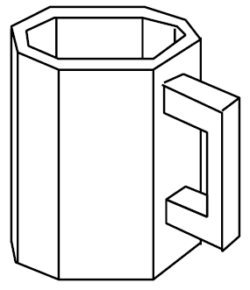
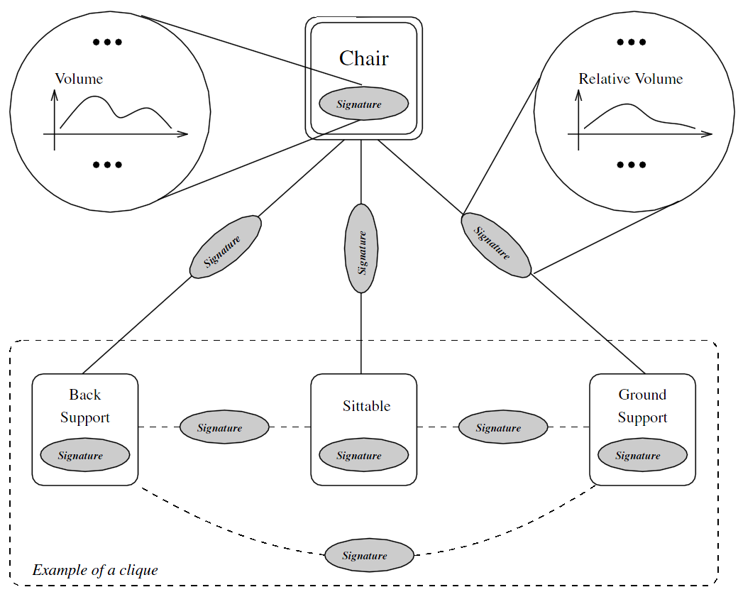
Previous works
Functionality models for individual shapes
Category: “generic mug”
Functional requirements:
Mug containment
Stability
Graspable handle
Sutton et al. [1994]
Pechuk et al. [2008]
Notes:
Previous works on functionality analysis have defined functionality in different manners.
In one class of methods, functionality models are handcrafted for specific object categories.
For example, [click] in the earlier work of Sutton and his colleagues, a mug is defined by a set of functional requirements. [click]
While Pechuk and his colleagues defined a hierarchical model based on functional parts and their relationships.
So, the obvious disadvantage of these methods is that a functionality model needs to be manually created for each possible shape class.

Slide 11
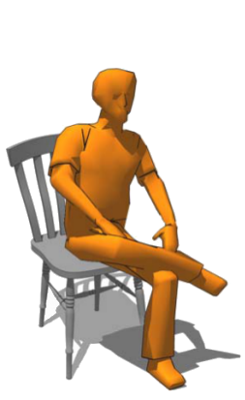
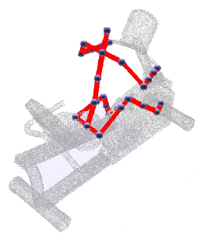
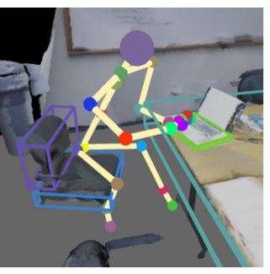
Previous works
Affordance analysis based on agent interaction
Grabner et al. [2011]
Kim et al. [2014]
Savva et al. [2014]
Notes:
Another line of work characterizes functionalities with an agent, most likely a human, interacting with an object. [click]
The agent can either be simulated or actually derived from observations of real humans
But for this kind of methods, we need to know and possibly model all types of agents that interact with the objects beforehand.

Slide 12
Our contribution
Contextual descriptor of an object based on interactions
Not category-specific
Not dependent on specific agents
Capture multiple interactions
No need for semantic labels
Notes:
So in contrast to these previous works, [click]
ICON is a contextual shape descriptor which infers object functionality based on interactions. [click]
So ICON is not category-specific, [click]
And different from methods based on affordance analysis, the interactions we consider are not confined to those involving humans [click] and we can capture multiple interactions. [click]
Moreover, by providing a geometric representation of the interactions, semantic labels of the scenes are not needed [click]
Now I will give more details about ICON construction.

Slide 13
3D shape
Notes:
Given a 3D shape, as mentioned before, instead of considering this individual shape alone,

Slide 14
Surrounding scene
Central object
Notes:
We look at its context and the way how it is used
We call the given shape shown in orange as central object

Slide 15
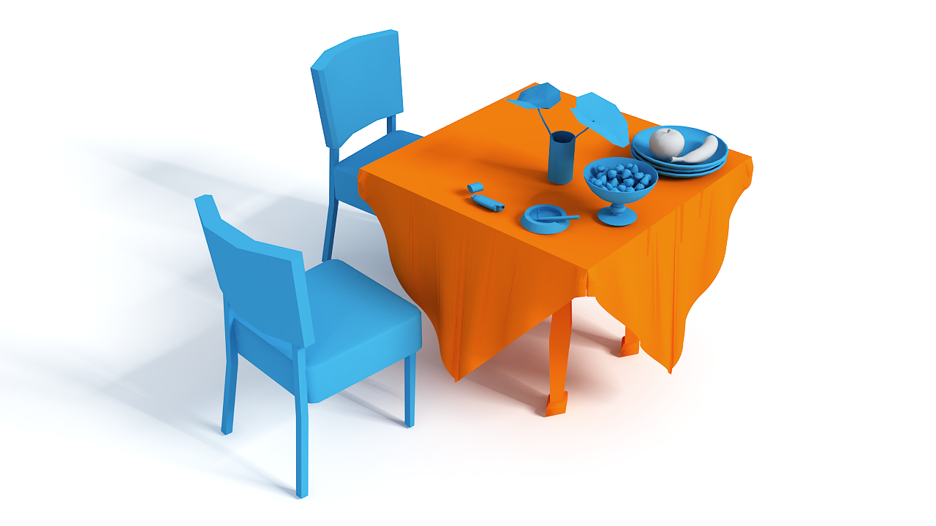
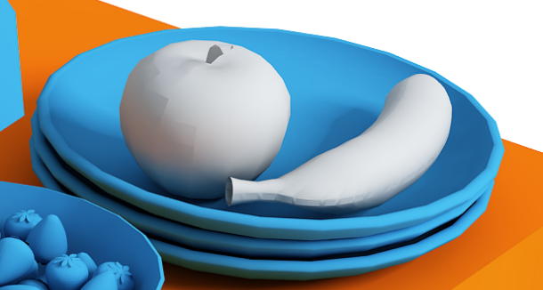
Interacting objects
Notes:
We first detect the objects that interact with the central object, shown in blue here.
Note that not all the objects in the scene are interacting objects, [click] for example, the apple and banana in this case

Slide 16
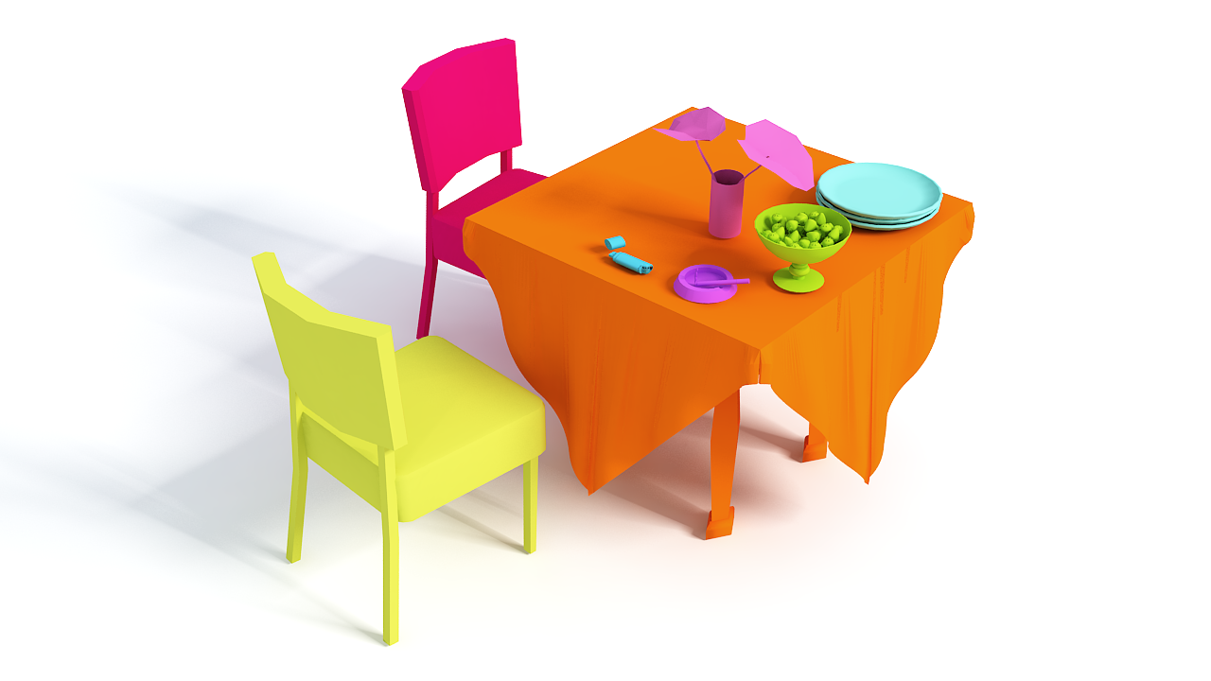
Interacting objects
Notes:
Then we analyze the interaction between the central object and each interacting object one by one.

Slide 17
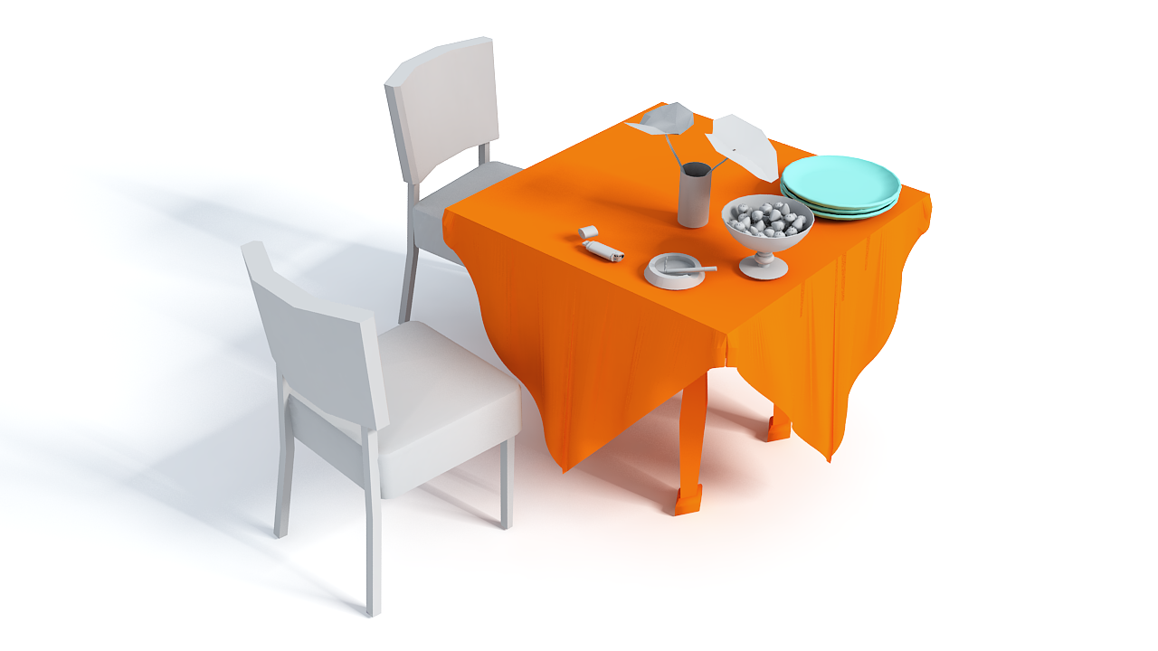
Interaction
Notes:
Take the plates model as an example.

Slide 18
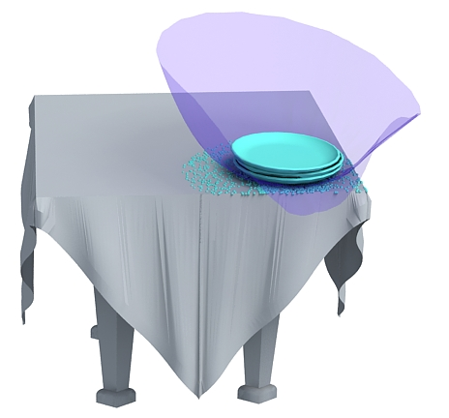
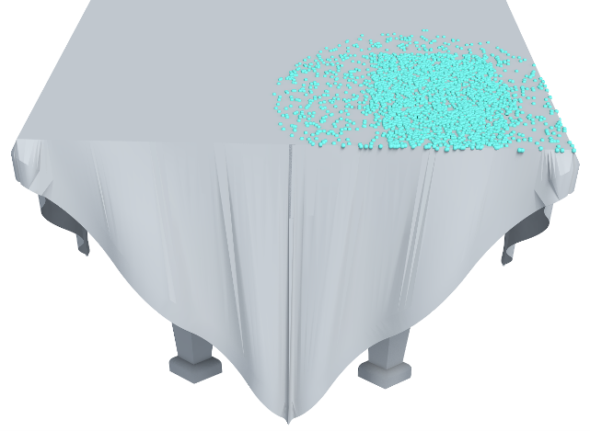
Geometric representation
Interaction Bisector Surface
[Zhao et al. 14]
Interaction Region
Notes:
We propose a geometric representation for the interaction, which consists of two components called IBS [click] and IR [click].
IBS, [click] short for interaction bisector surface, is the purple surface here which captures the spatial boundary between two objects
While [click] IR is short for interaction region, which is used to describe the geometry of the surface region on the central object corresponding to the interaction.

Slide 19
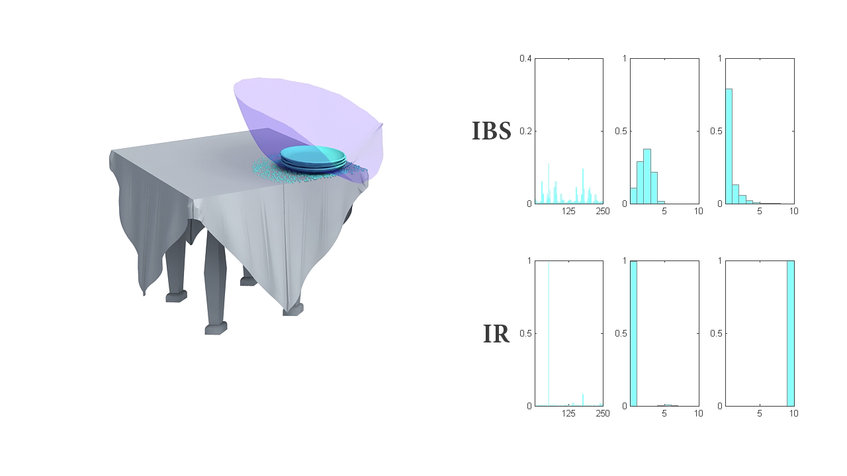
Geometric representation
Notes:
IBS and IR are then represented with [click] descriptive features, summarized with three histograms each shown on the right.

Slide 20
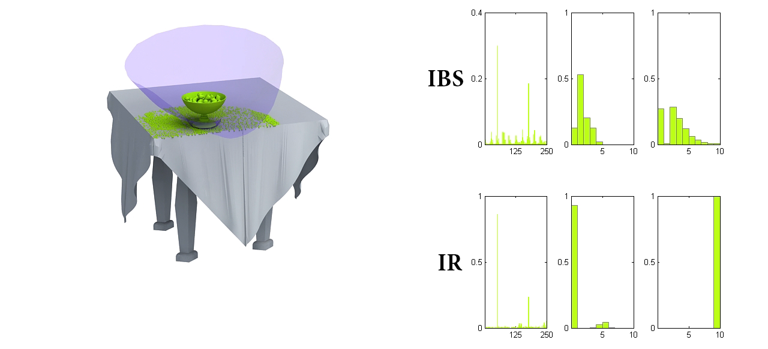
Geometric representation
Notes:
Here you can see IBS and IR of two other interactions, with their corresponding features

Slide 21
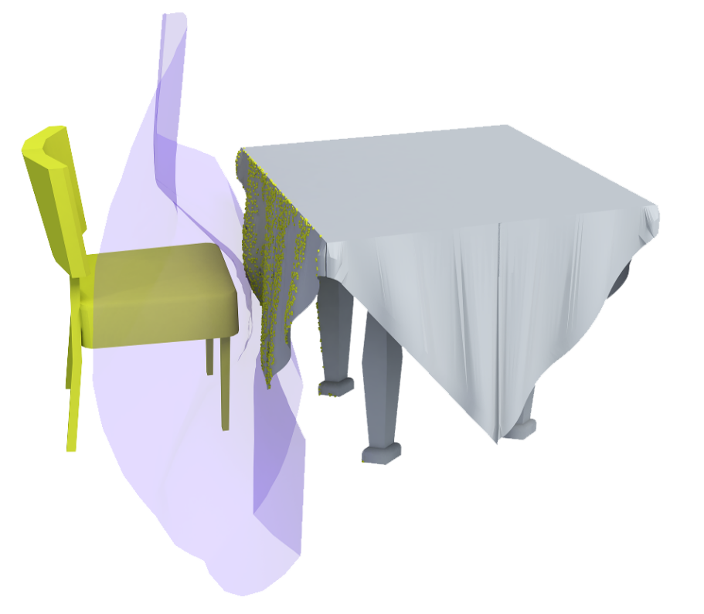
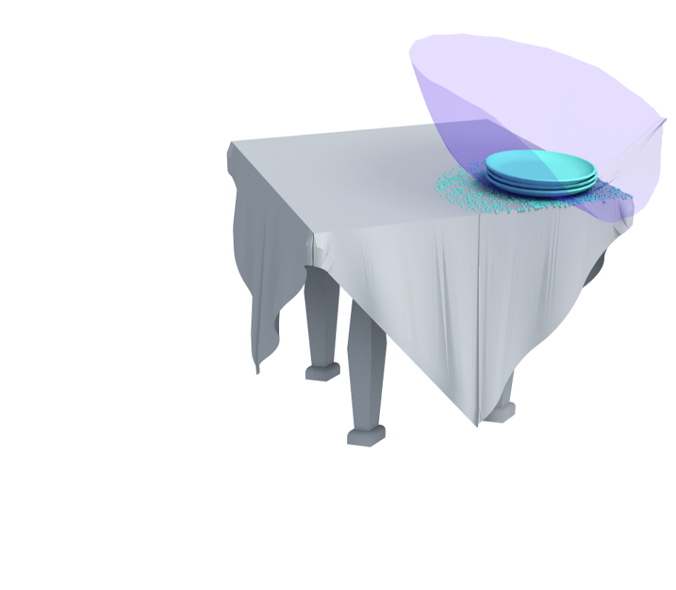
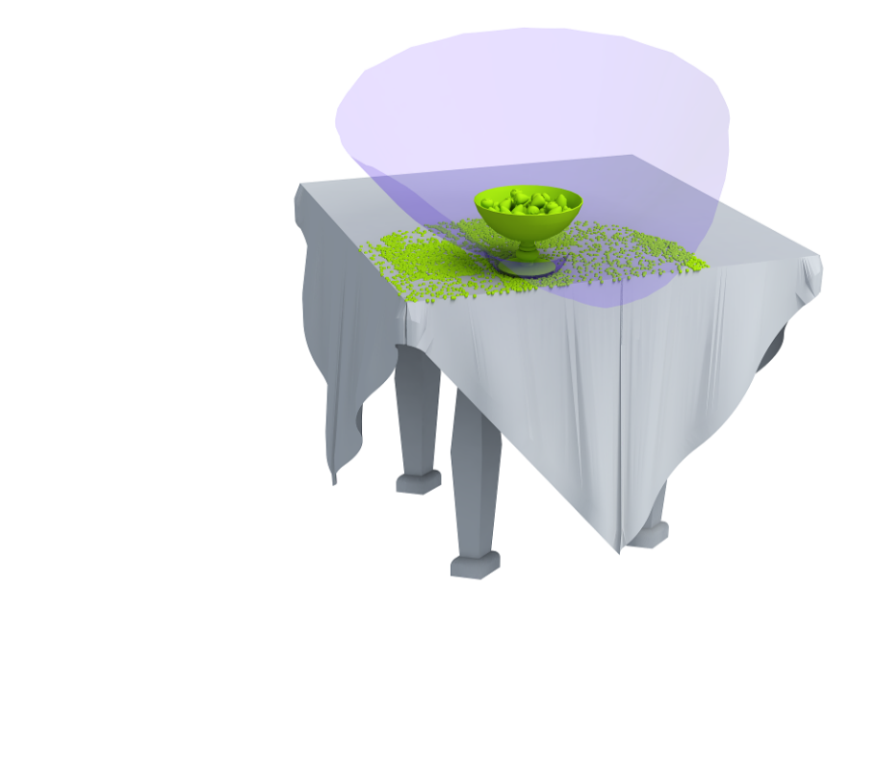
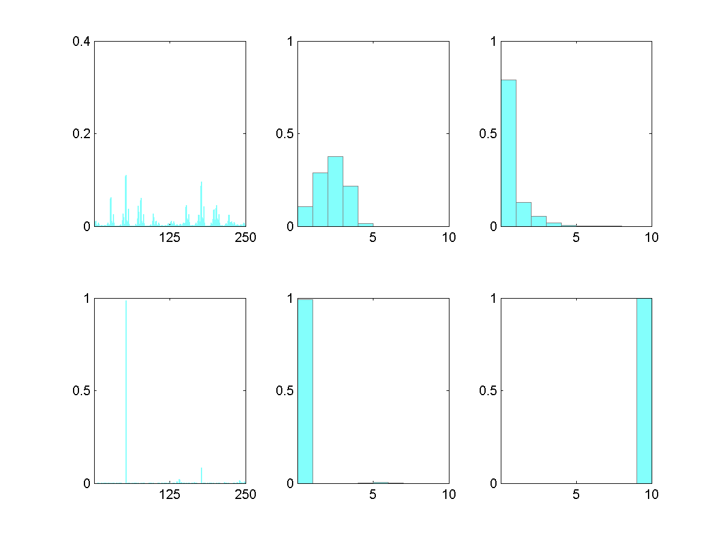
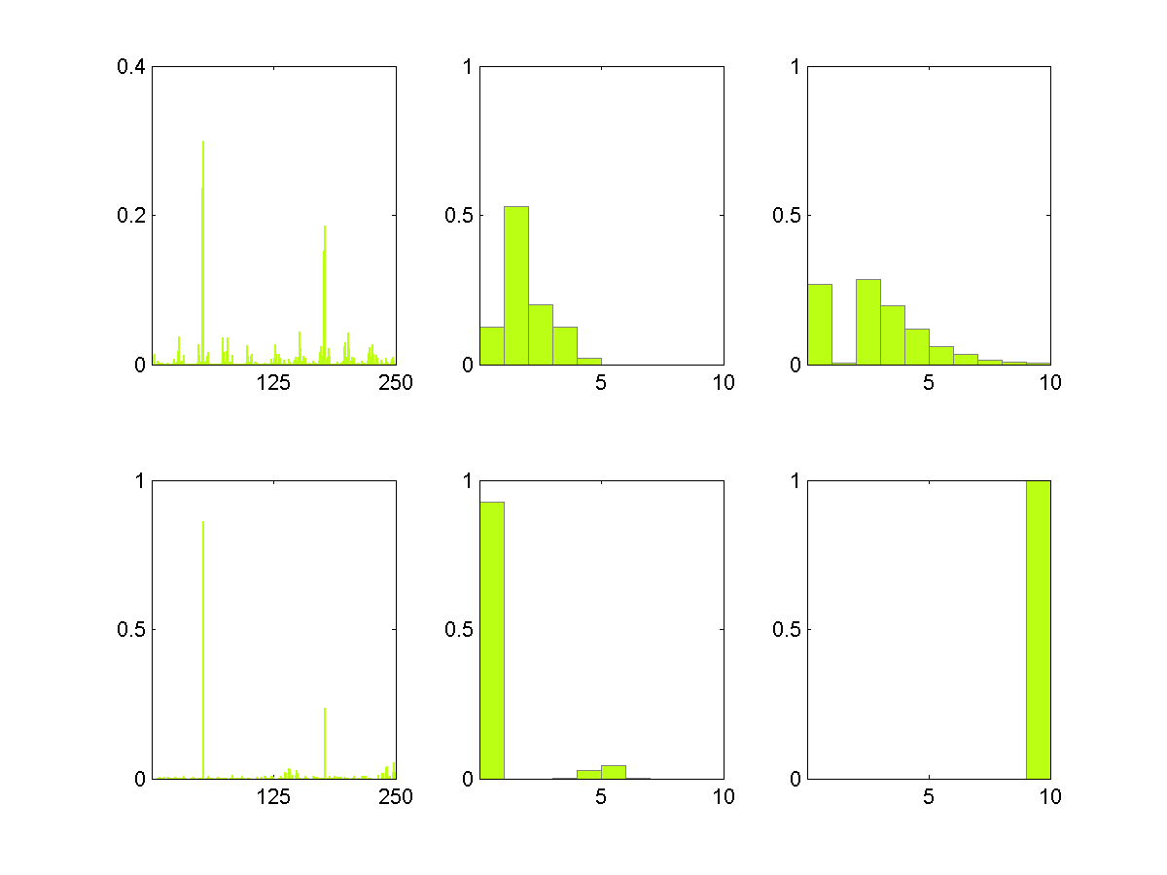
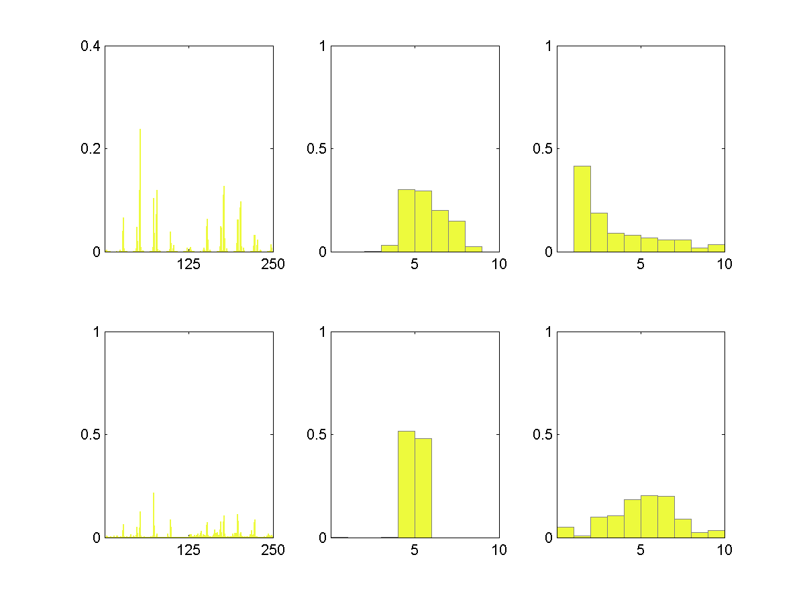
Geometric representation
IBS
IR
Notes:
The features capture several geometric properties of interactions, which can be used to define interaction distance
For example, [click] the features of interactions between the table and objects on its top are similar, but different from the interaction with the chair. [click]
Especially for the IR features in this case.

Slide 22
ICON construction
0.748
0.180
0.171
0.748
0.135
0.062
0.180
0.171
0.043
Initial
binary hierarchy
Final
hierarchy
ICON
Notes:
After providing a geometric representation for each interaction in the context, [click]
we first construct an initial binary hierarchy based on the interaction distance we defined [click]
and then convert it into one or more hierarchies by merging multiple nodes to remove cases where the binary branching is almost arbitrary. [click]
ICON is the set of all the possible final hierarchies.

Slide 23
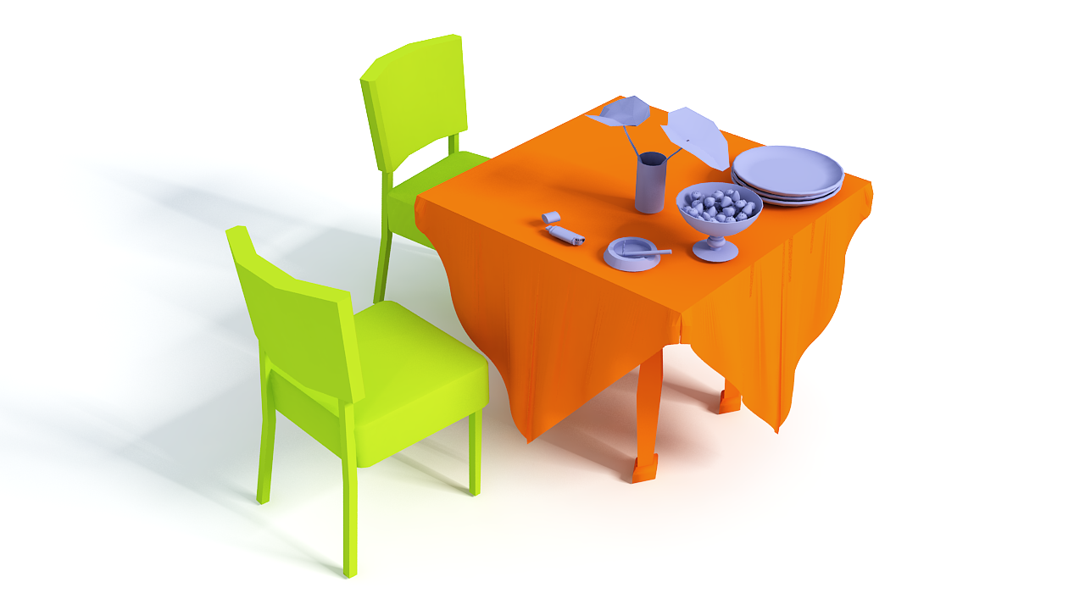
ICON
Notes:
To have a better understanding of ICON’s nice properties, we simplify the illustration a bit by rendering the objects which have same type of interaction in the same color
[click] Each leaf node in this tree represents an interaction between an interacting object and the central object.

Slide 24
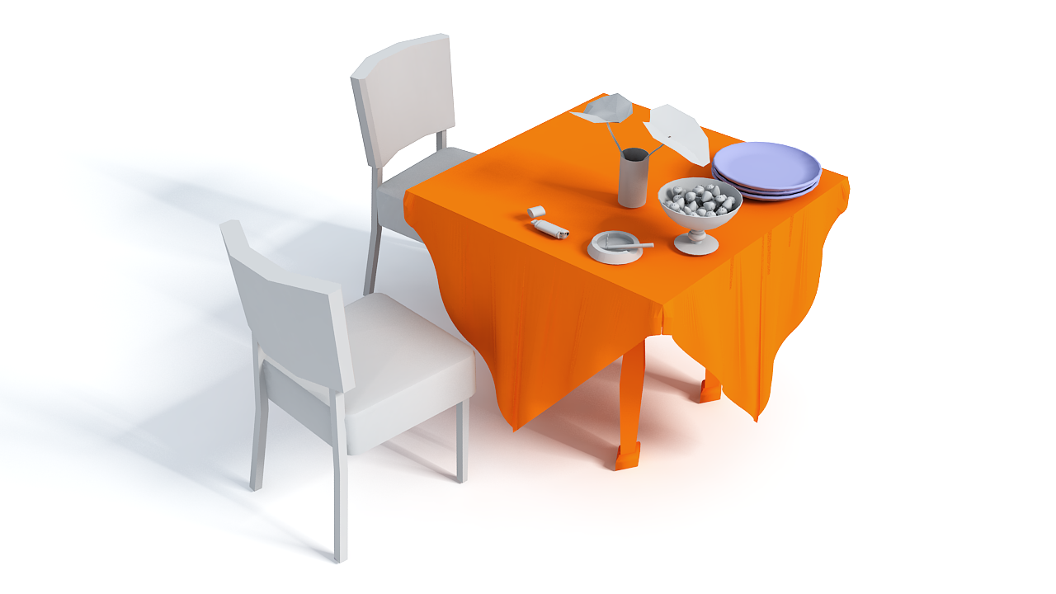
ICON
Single object interaction
Notes:
For example, this node corresponds to the interaction between the plates and the table

Slide 25
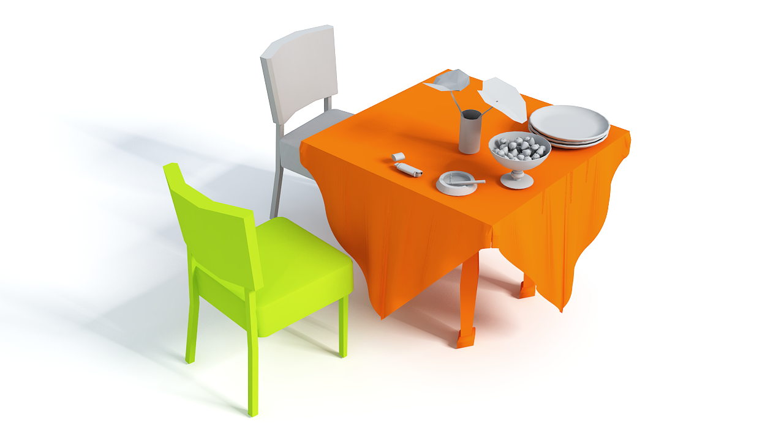
ICON
Single object interaction
Notes:
While this node corresponds to interaction between the chair and the table

Slide 26
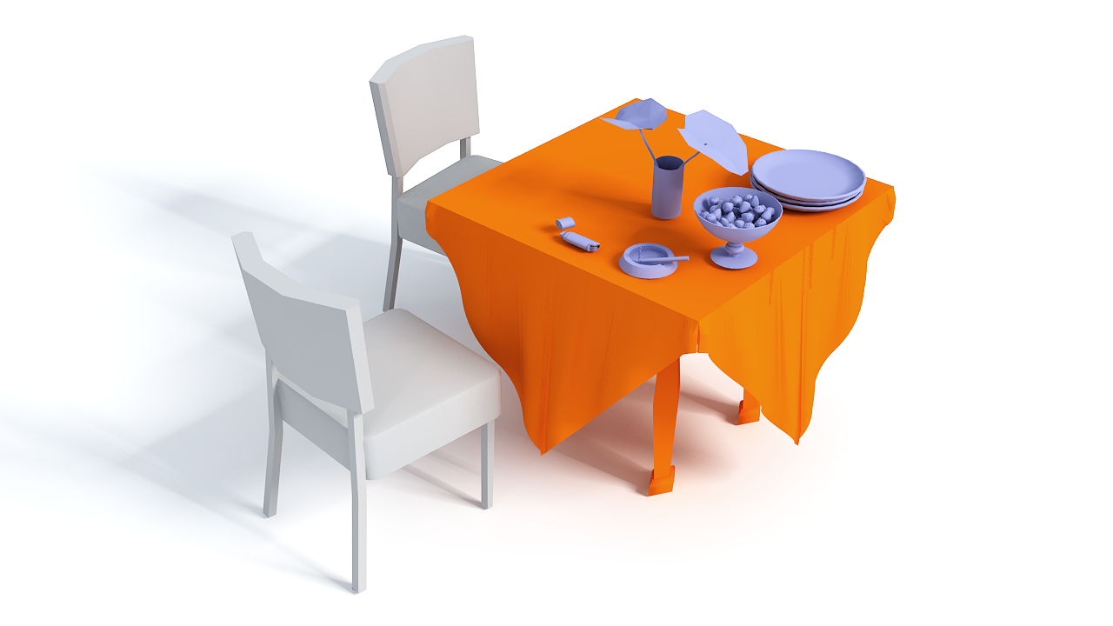
ICON
Group interaction
Notes:
The nodes at higher levels of the hierarchy represent a general interaction type, for example, support

Slide 27
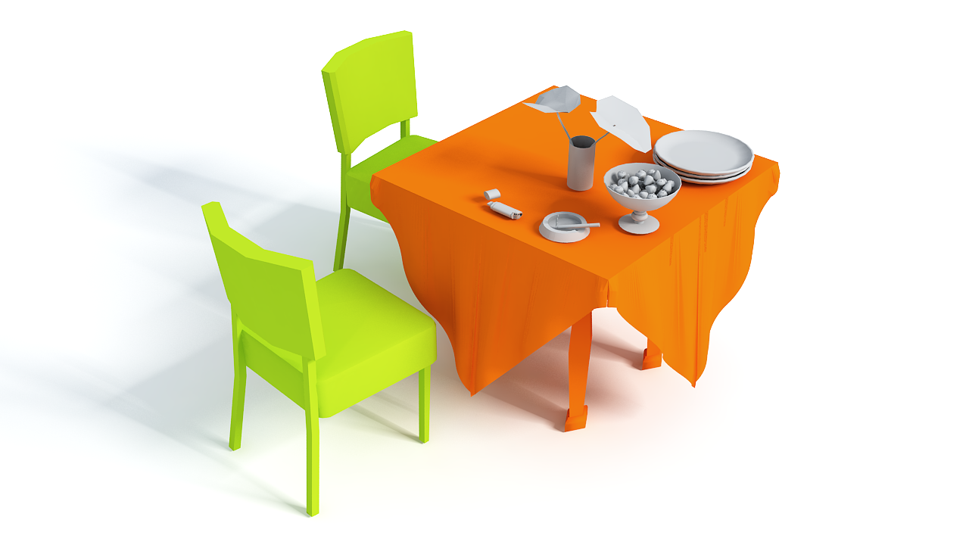
ICON
Group interaction
Notes:
And this intermediate node represent the interaction between all the chairs and the table

Slide 28

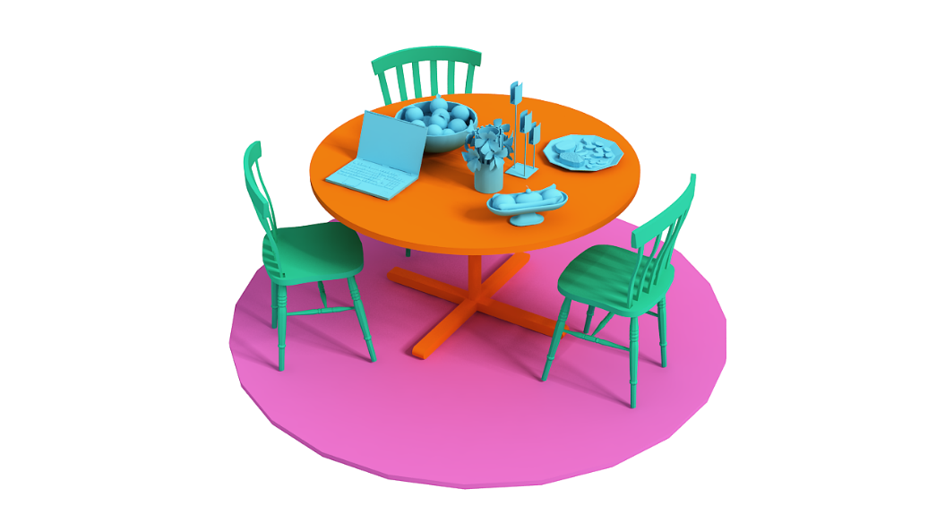
ICON comparison
Subtree isomorphism
Notes:
To compare two ICON descriptors, we find the best matching between the trees via subtree isomorphism [click]
The matching is based on interaction features of each node.
Based on this design, ICON possesses several useful properties which address the challenges mentioned before.

Slide 29
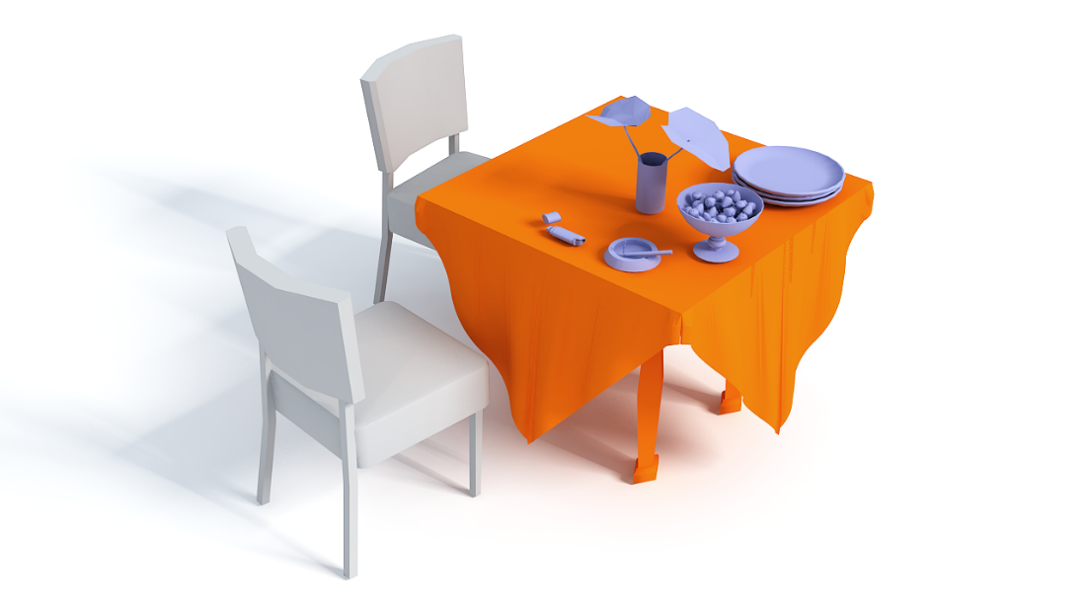
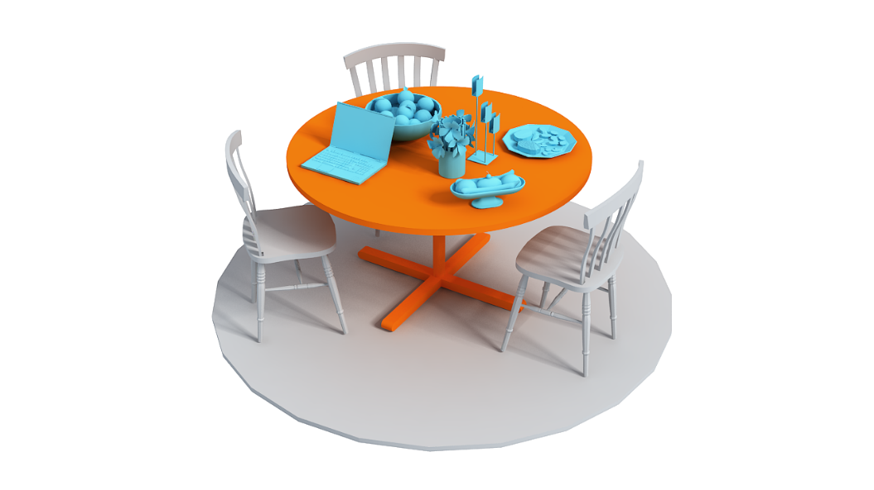
ICON comparison
Insensitive to number and geometry of objects
Notes:
First, ICON is not sensitive to the number and geometry of objects that appear in the scenes. [click]
For example, here we see a table matched to another table with similar functionality but different number of objects on their tops.

Slide 30

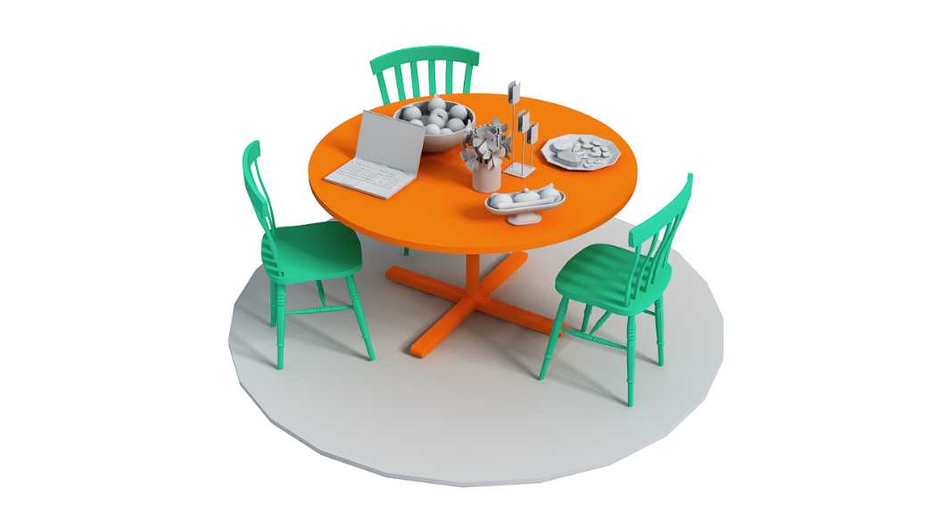
ICON comparison
Insensitive to specific disposition of objects
Notes:
Second, ICON is not sensitive to the specific disposition of objects around the central object, [click] as we see with the chairs around the tables.

Slide 31
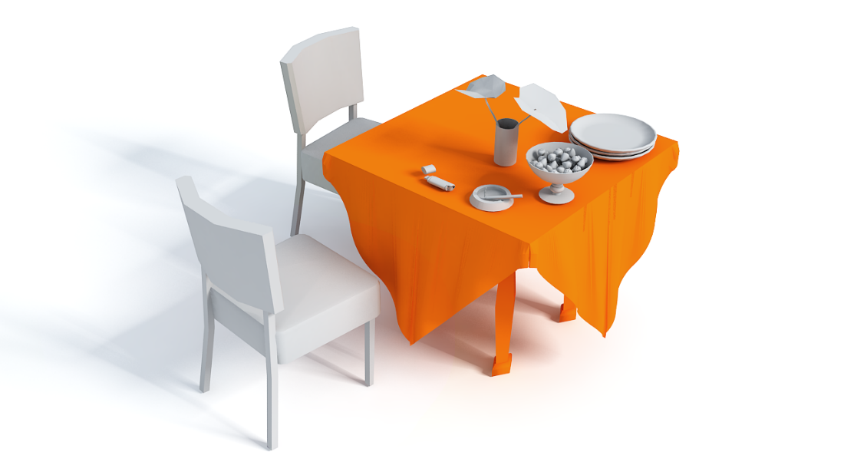
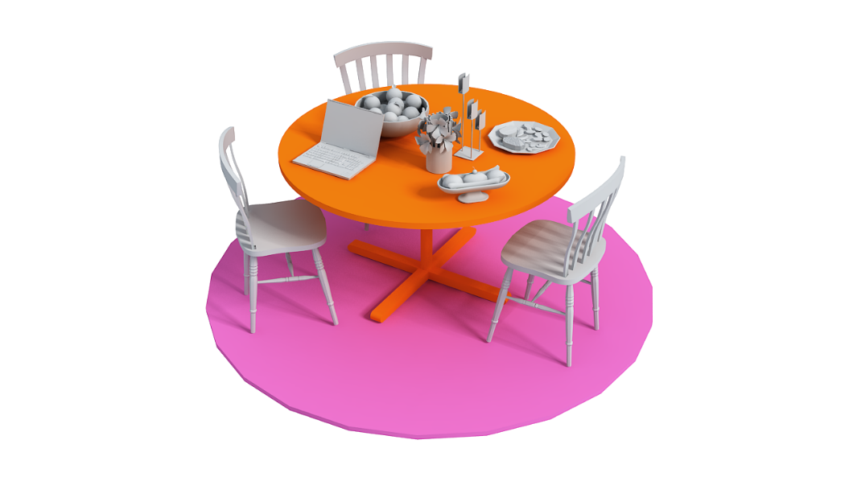
ICON comparison
Allow partial matching
Notes:
Moreover, [click] interactions that differ significantly in their features are unmatched.

Slide 32
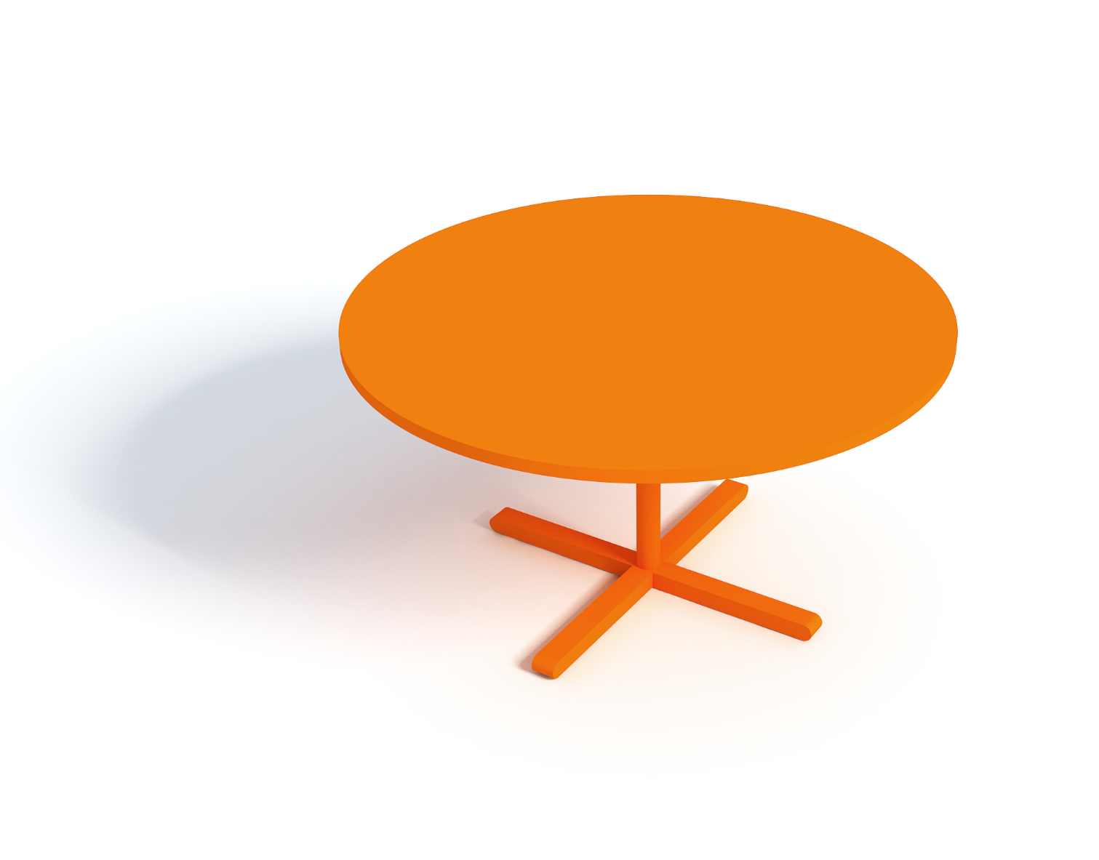
ICON comparison
Similar functionality but different geometry
Notes:
Based on ICON, we now know that these two tables have similar functionality even though their geometry differs a lot.

Slide 33
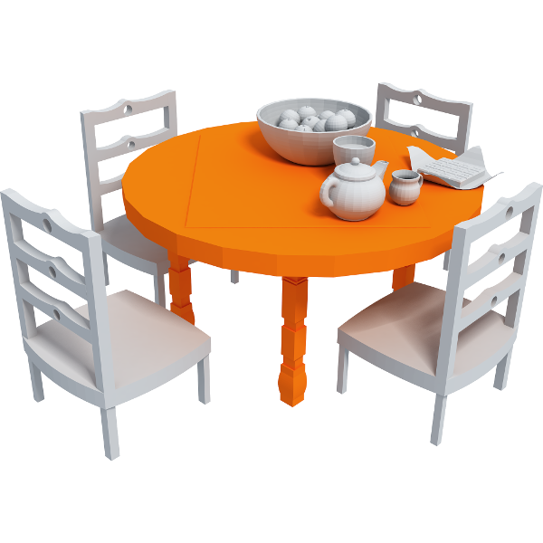
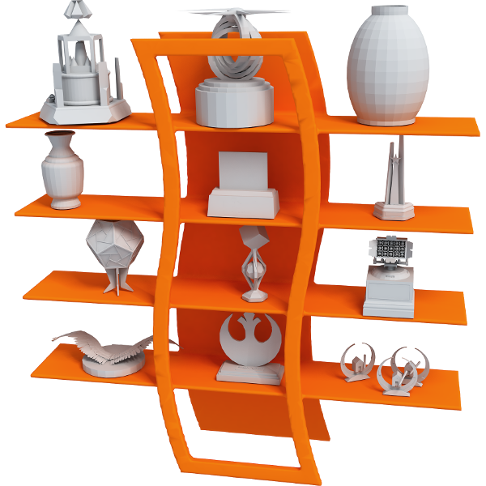








Dataset
Table
Shelf
Handcart
Vase
Stand
Desk
TV bench
Stroller
Basket
Hook
Notes:
To evaluate ICON, we construct a dataset of scenes composed of manmade objects,
and further group these scenes into 10 different categories according to the primary functionality of the central object,
each category has 10-15 models

Slide 34

Embedding
ICON MDS
LFD MDS
Notes:
Now let’s first look at an embedding of all the objects in our datasets [click] to have a big picture of how ICON performs.
Here, each point denotes a shape in our dataset and the points are embedded in 2D based on the descriptor distances of [click] ICON on the left and [click] the light field descriptor on the right. [click]
The embedding derived from ICON better groups objects according to their functionality.
Classes with overlap, [click] such as Shelf and TV bench shown in yellow circles and boxes here, usually have similar or related functionalities.
Among highly distinct functionalities, [click] for example Shelf and Basket shown in yellow and red circles here, there is a clear boundary between them. [click]
While in light field descriptor embedding, points get mixed up

Slide 35










Application
Query
Top retrievals
Notes:
As an explicit representation of the functionality of an object, [click] ICON can serve applications that require comparing the functionality of objects, [click] for example, functional shape retrieval.
Here are the retrieval results for a table and a desk.
We see how the objects retrieved are functionally similar to the queries, although their geometries and surrounding objects in the scenes are quite different

Slide 36










Application
Query
Top retrievals
Notes:
We observe a similar result for handcarts and strollers
Note that multiple interactions have to be considered to fully characterize and differentiate those objects.

Slide 37


Comparison
Other descriptors
ICON’s design aspects
Notes:
To perform a quantitative evaluation of ICON, we compare the retrieval performance of ICON against alternative approaches with a precision and recall experiment.
From the graph on the left, we see that ICON performs better than descriptors computed only on the individual shape or other hierarchical groupings.
For the details of this evaluation, and how we evaluate different aspects of ICON’s design shown on the right, please refer to the paper.

Slide 38










Comparison
Human pose
Query
ICON
Pose
Notes:
In terms of functionality representation, we compare ICON to the use of human poses.
We note that those two approaches are comparable in practice, while each one has its own advantages.

Slide 39
Functionality transfer
Notes:
Finally, we explore ICON’s potential in enabling a different type of shape segmentation. [click]
Given the scenes on the left, [click]
we are able to segment the central objects into regions that serve the same type of interactions. [click]
A potential application is to transfer or combine some of these interacting regions to synthesize new shapes, which resemble multi-function objects in real life .

Slide 40


Limitations
Non-geometrical
Dynamic movement
Notes:
In terms of limitations, ICON is not designed to encompass all functionalities, [click] like those offered by a smart phone which are non-geometrical or [click] a human hand which involves dynamic movements. [click]
In our setting, we focus on functionality that can be derived from the interactions between multiple objects in a static scene.

Slide 41



Limitations
Data dependence
Positions of interactions
Notes:
But data dependence [click] is a limitation when the input scenes have interactions that are inadequate to describe the functionality of central objects, e.g., the bike and stand are recognized as functionally similar because the only interactions present in the scenes are hanging bags. [click]
Also, we do not encode the relative positions of interactions on the central object.
While in some cases the relative position of different types of interactions is the only cue to distinguish the functionality of different objects, e.g., the basket and wheelbarrow.

Slide 42
Conclusion
Interaction Context (ICON)
Geometric representation and organization
Starting point for geometric functionality descriptor
Notes:
So, to summarize, [click]
We proposed a contextual shape descriptor called ICON to reflect object functionality based on interactions in a given context. [click]
By providing a geometric representation and organization of the interactions in the context of the central object, [click] We believe that ICON can constitute the starting point for developing a geometric functionality descriptor, which describes the functionality of an object based on geometric information only

Slide 43


Future work
Additional features
Co-analysis
Part-level ICON
Notes:
In terms of future work, we think there are much more to explore. [click]
For example, we can incorporate additional features to better describe both IBS and IR. [click]
ICON should also be applicable in a co-analysis setting. [click]
Moreover, we presented a preliminary version of a part-level ICON in the paper to demonstrate its potential as a descriptor for shape parts, where each part can be considered as an object and the entire shape will be its context as in our setting.
However, there are further challenges specific to part representations need to be addressed.

Slide 44

Thank you!
vcc.siat.ac.cn/~ruizhenhu/projects/icon
ACKNOWLEDGMENTS
Anonymous reviewers & funding from
GRAND NCE, NSFC, CPSF
Notes:
Finally, [click] dataset and source code are available at our project page, welcome to download and try! [click]
I’d like to thank the anonymous reviewers for their suggestions and our funding agencies [click]
And thank you for your attention!

Slide 45

Appendix

Slide 46
Functionality
“Particular use for which an object is designed”
-- [Merriam-Webster]
“Application of an object in a specific context for the accomplishment of a particular purpose”
-- [Bogoni and Bajcsy 1995]
Notes:
But, what is functionality? Different definitions have been proposed.
For example, the dictionary says that <read definition 1>, while a more refined definition states that <read definition 2>.

Slide 47

Dataset
Notes:
Note that most of those scenes are subscenes extracted from scenes in well-known datasets.
This is similar to using the entire scene because objects far away hardly interact with the central object.

Slide 48


Dataset
Require object given in context of a scene
SketchUp 3D Warehouse
TurboSquid
Notes:
On the other hand, note that to build an ICON for an object, the object needs to be given in an appropriate context. Nevertheless, we foresee that more an more datasets composed on entire scenes will be available. As the efforts in modeling the world continue, these datasets will increase in complexity and incorporate more realistic details in the future.

Slide 49

Compare to IBS
IBS hierarchy
ICON hierarchy

Slide 50
Comparison
To other descriptors
Notes:
To perform a quantitative evaluation of ICON, we compare the retrieval performance of ICON against alternative approaches with a precision and recall experiment. We see on the graph of the left that ICON performs better than descriptors computed only on the individual shape or other hierarchical groupings. For the details of this evaluation, please refer to the paper.

Slide 51
Comparison
ICON’s design aspects
Notes:
To perform a quantitative evaluation of ICON, we compare the retrieval performance of ICON against alternative approaches with a precision and recall experiment. We see on the graph of the left that ICON performs better than descriptors computed only on the individual shape or other hierarchical groupings. For the details of this evaluation, and how we evaluate the different aspects of ICON’s design on the graph on the right, please refer to the paper.

Slide 52

Symmetry
Effect of symmetry in the construction of ICON
With symmetry
Without symmetry
Notes:
When the pattern of the shelves (left) is taken into account in the construction,
the resulting hierarchy in (middle) groups objects according to the symmetry structure of the central object.
In (right), we see that the construction without symmetry consideration groups objects more arbitrarily (arrows in (left) and red boxes in (right)).

Slide 53

Part-level ICON
Notes:
To show the potential of our preliminary extension of ICON to the domain of shape parts, we perform an evaluation of the part-level descriptor on a set of shapes from the same class.
Given a segmented shape, we describe each segment or part with an ICON descriptor that captures the interactions of the part with all of its neighboring parts.

Slide 54










Shape retrieval
Notes:
TV benches and shelves are also retrieved according to their functionality.

Slide 55








Shape retrieval

Slide 56










Shape retrieval

